Slide 1
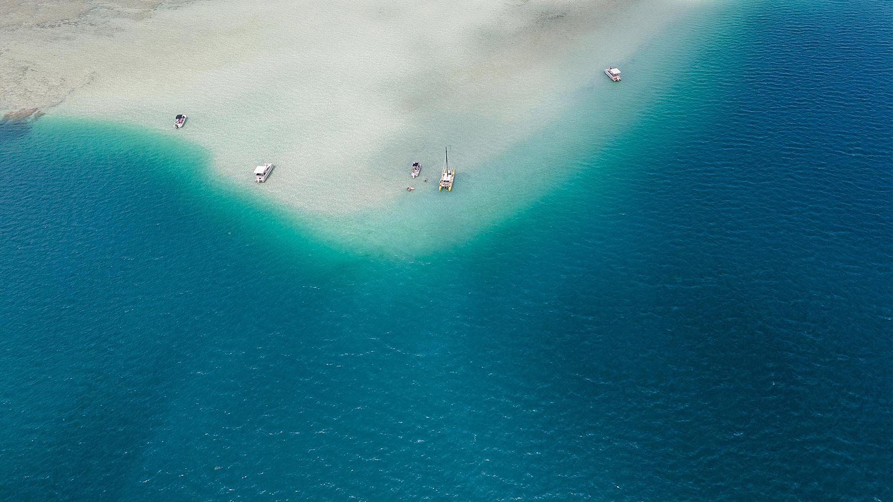
Jacques-Yves Cousteau
a French naval officer, oceanographer, filmmaker and author

Slide 2
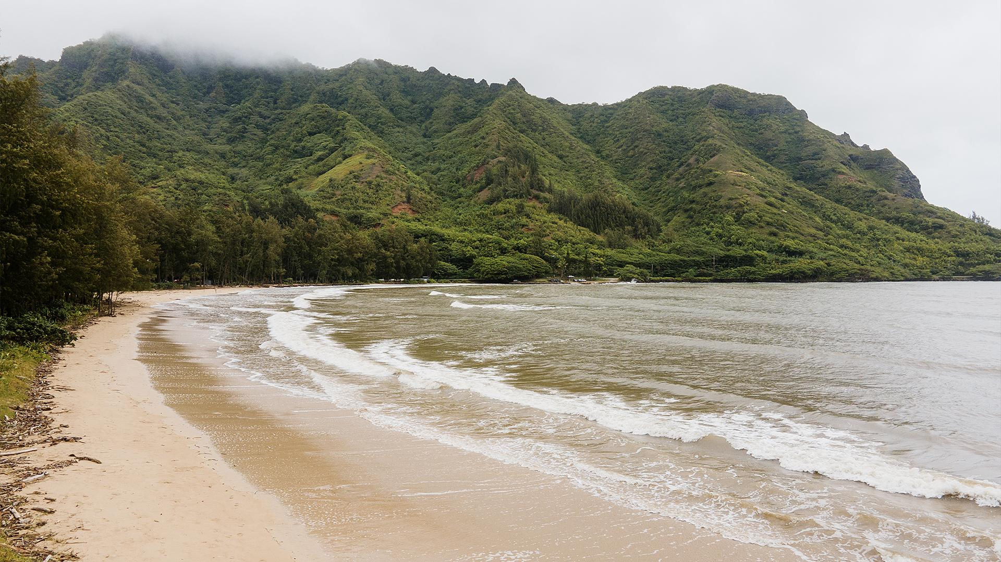
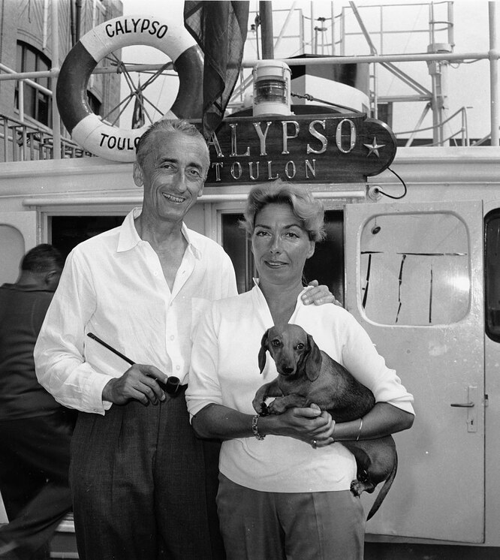
Biography
Cousteau was born on 11 June 1910, in Saint-André-de-Cubzac, Gironde, France and died on 25 June 1997. On 12 July 1937, he married Simone Melchior, his business partner. They have two sons and thats sons take part in the adventures of the Calypso.
In 1991, six months after his wife Simone's death from cancer, he married Francine Triplet. They already had a daughter and son, who was born while Cousteau was married in his first wife

Slide 3
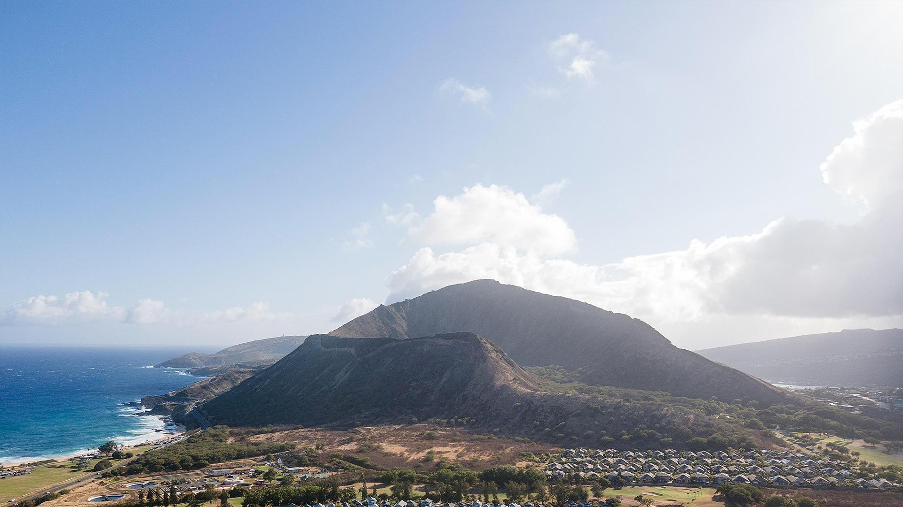
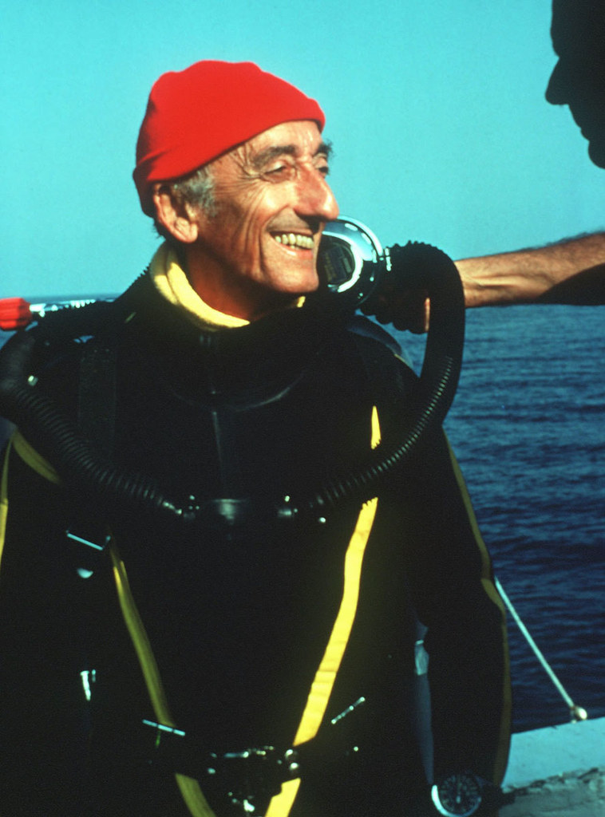
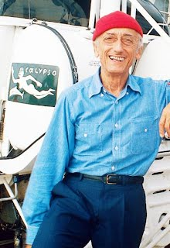
Jacques Cousteau appearance
Jacques Cousteau was a tall and skinny man with big eyes, a noticeable nose, and a strong jaw. He was known for wearing a red beanie cap and a blue-and-white striped shirt, which became his signature outfit. He often wore a black diving suit with a scuba tank and mask during his underwater explorations.

Slide 4
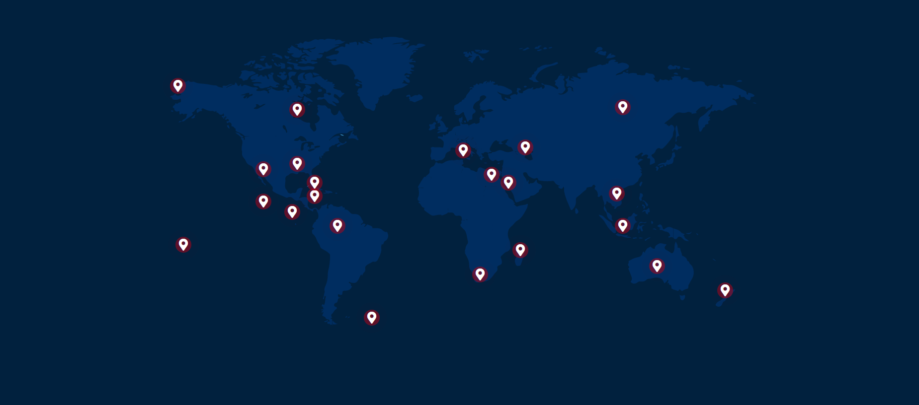
Map of his expeditions

Slide 5
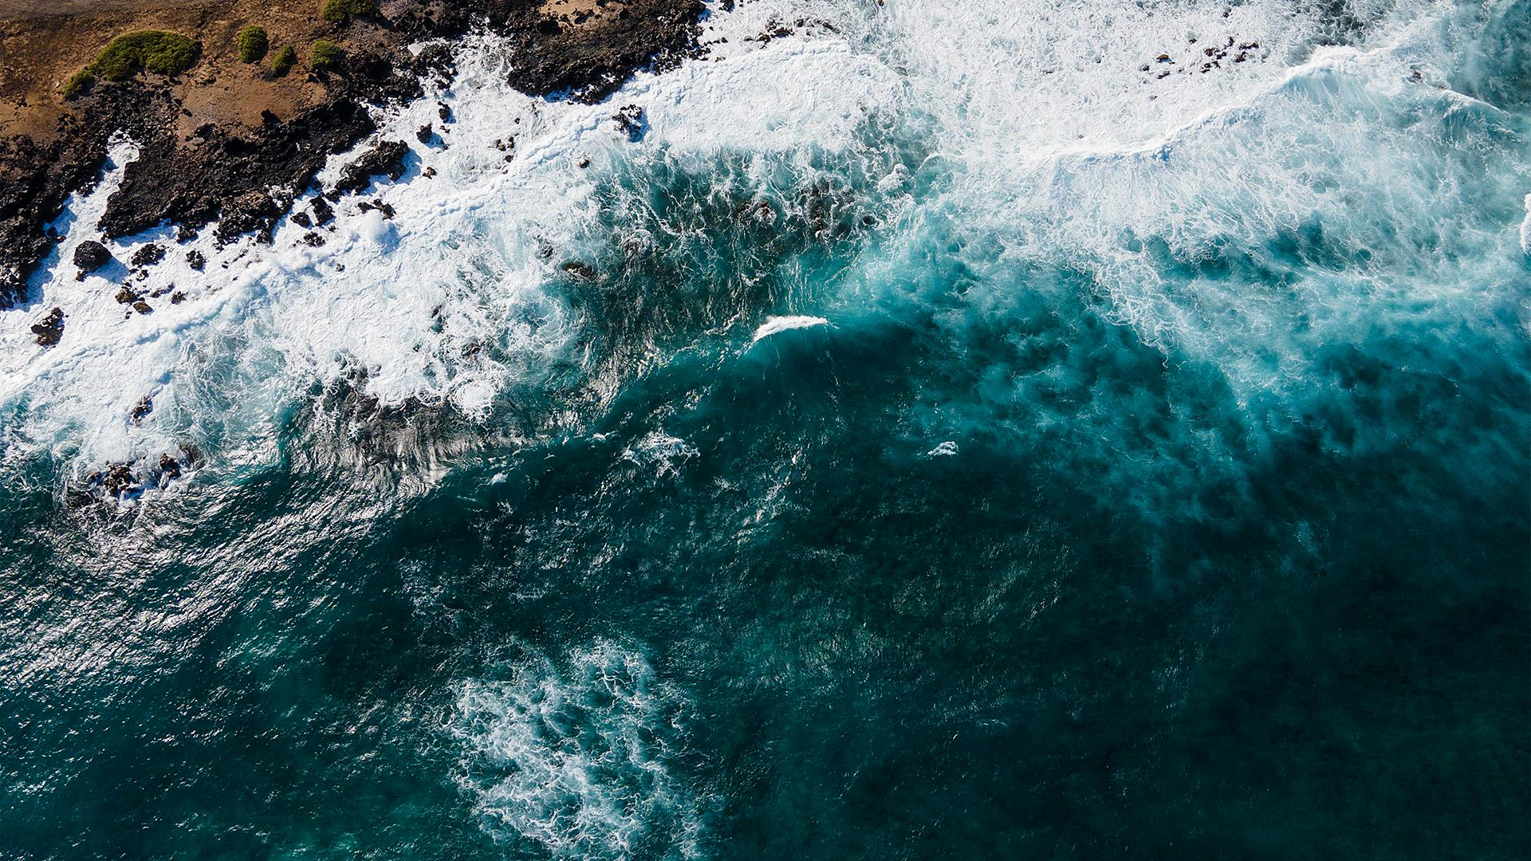
Expeditions
Alaska
Canada
Madagascar
1989
«You can walk for days on end without meeting another living soul»
In the early 1980’s
«The Nature that the crew encountered was grandiose, but also damaged»
1994
«A future harmony between humans and Nature was still possible»
Mississippi
Caribbean Sea
Nile
1983
«From the air, a flying team recorded the broad sweep of the Mississippi, dubbed the “Father of Waters” by the Indians.»
1974
«Each shipwreck has a story—that of an owner, a captain, a crew…»
1979
«From its source in Lake Victoria in Uganda to the Delta at Cairo, the Nile crosses marshes and falls, bringing life wherever it flows»

Slide 6
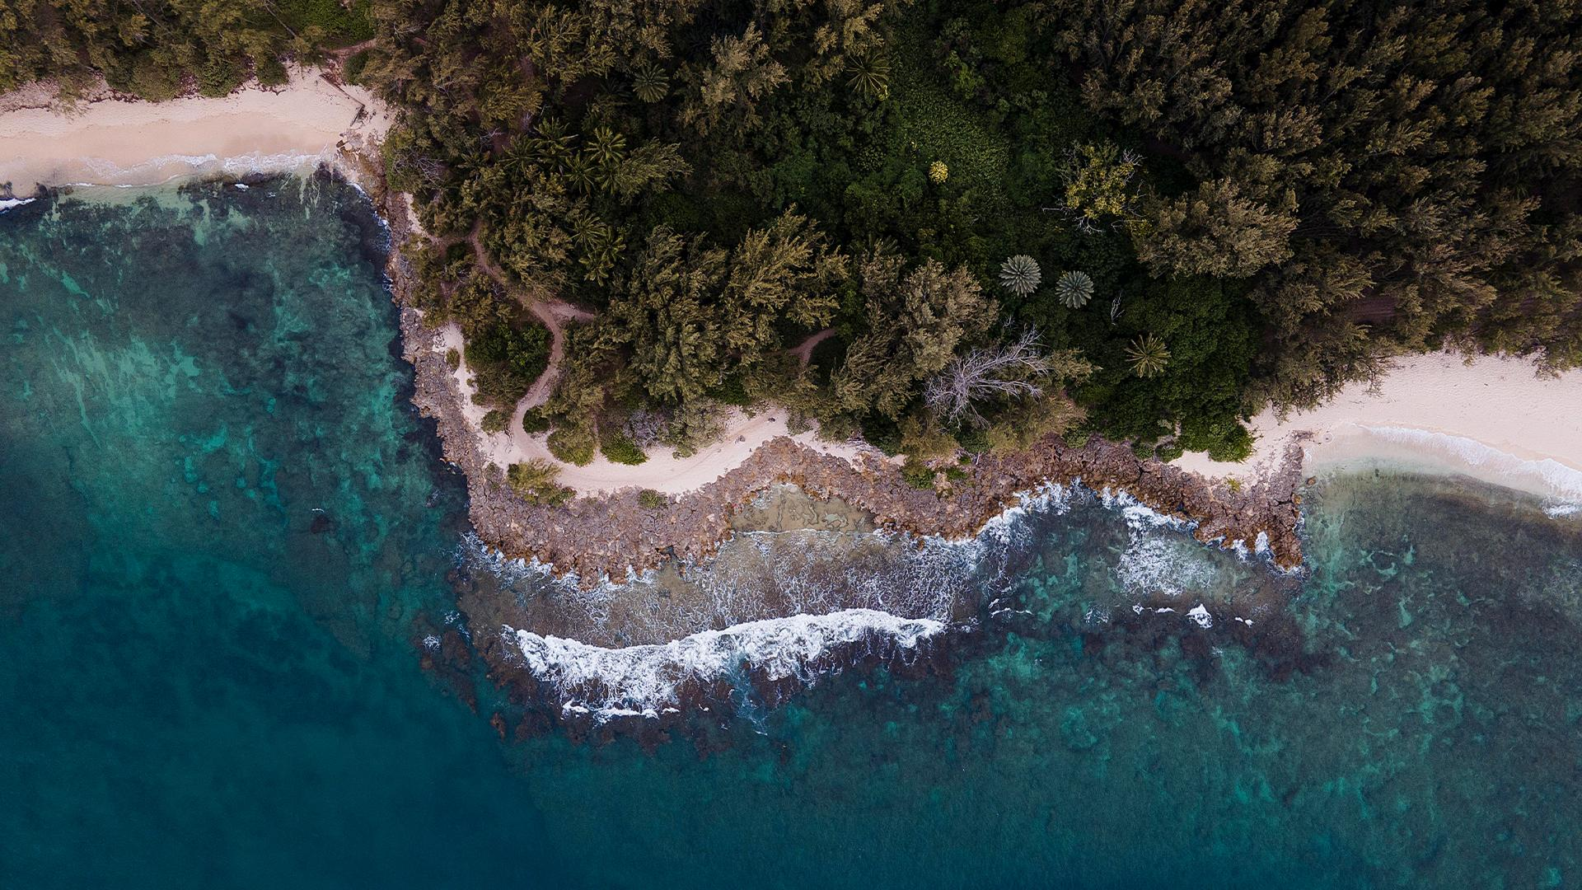
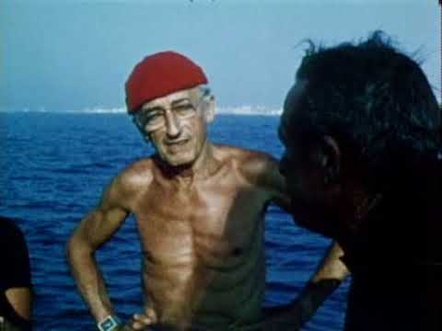
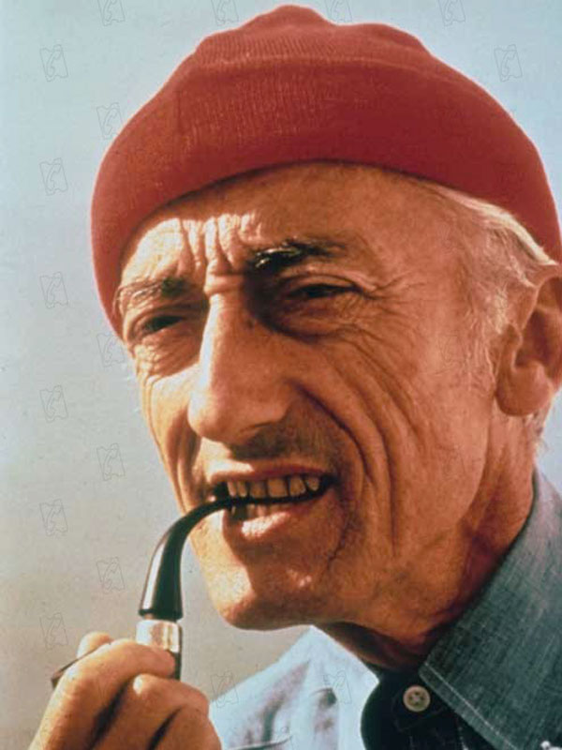
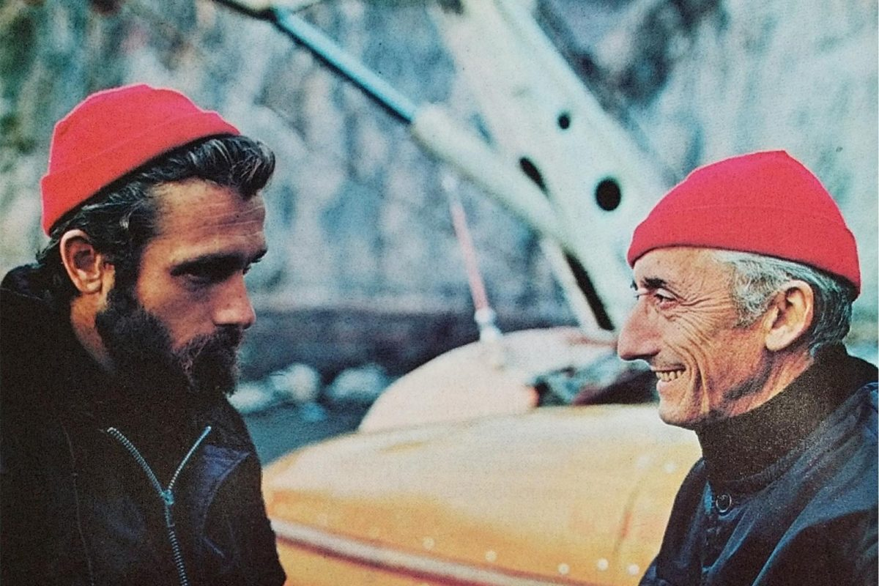
A RED HAT
Jacques Cousteau's signature red beanie was worn in homage to the 18th-century prisoners of Toulon, who were forced to test-dive the earliest metal diving suits. They had to sport red caps to differentiate them from the other port workers.
It was a woolly red hat
Cousteau gets a lot of mention on Red Hat Factory. The legend, the sea farer — or more accurately, below-sea farer — the style guru for Red Hatters across the world

Slide 7
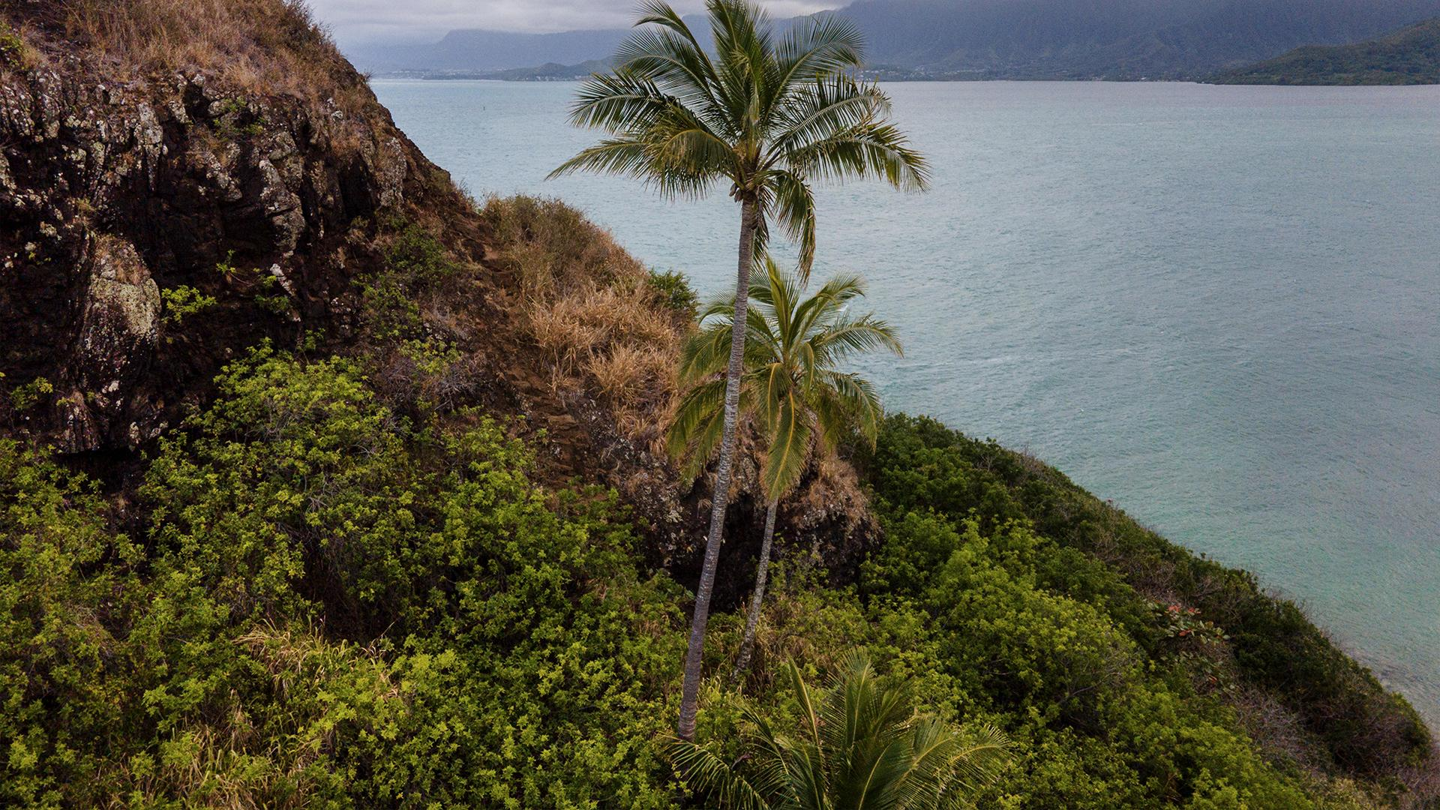
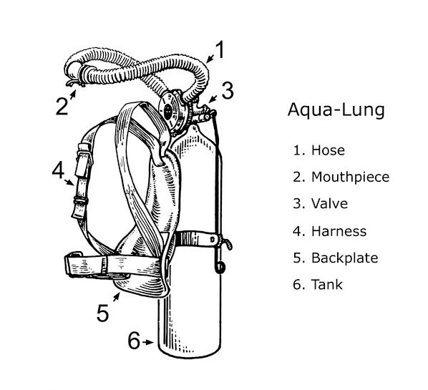
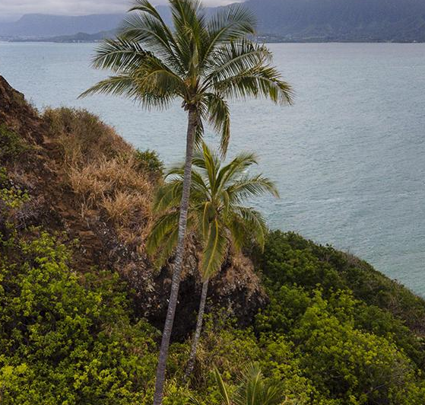
Cousteau's career
Cousteau's early career was in the French navy, where he trained as a gunnery officer and eventually became a captain. However, his passion for marine biology and oceanography led him to co-invent the Aqua-Lung, an underwater breathing apparatus that allowed divers to stay submerged for extended periods of time. This invention, along with his skill as a diver and filmmaker, enabled Cousteau to explore the oceans in ways that had never been done before.

Slide 8
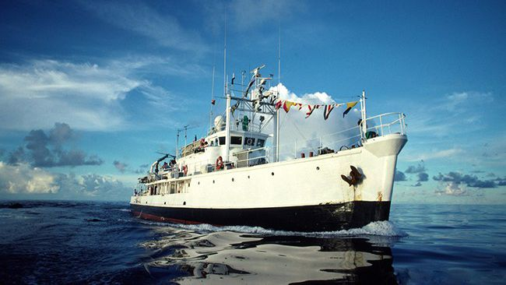
In 1950, Cousteau co-founded the French Oceanographic Campaigns (FOC), which conducted a series of expeditions aboard the Calypso, a converted minesweeper that served as a research vessel and floating film studio. Cousteau and his team explored and documented many of the world's oceans, from the Mediterranean to the Red Sea, from the Indian Ocean to the Pacific.
They made a number of groundbreaking discoveries, including the existence of previously unknown underwater ecosystems and the use of scuba diving for scientific research.

Slide 9
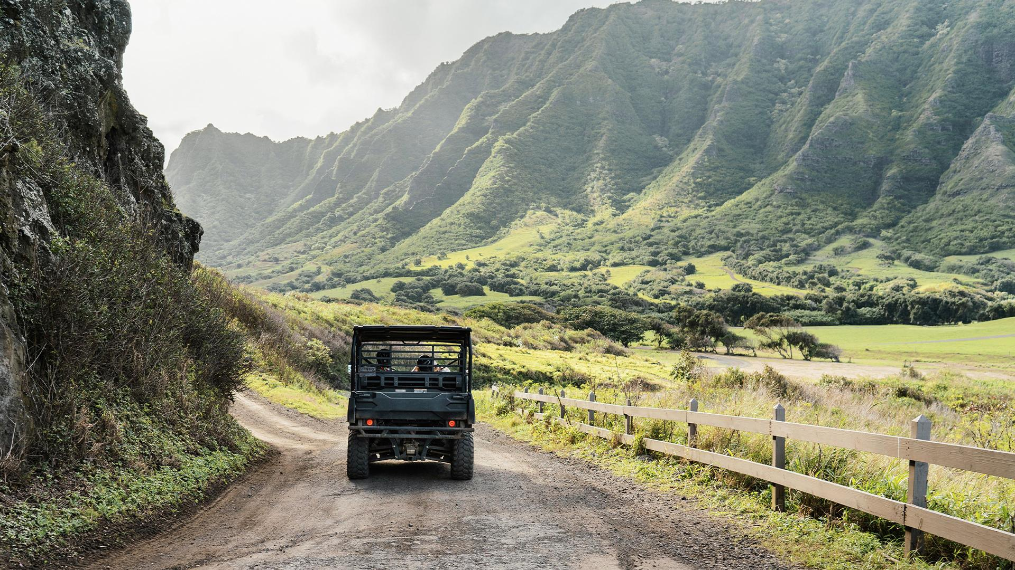
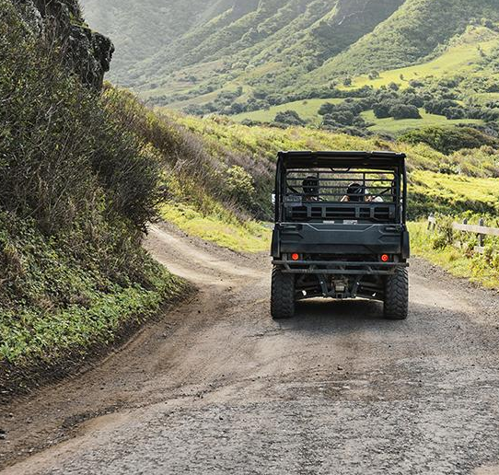
—Jacques Cousteau's
"The sea, once it casts its spell, holds one in its net of wonder forever."
‘22

Slide 10
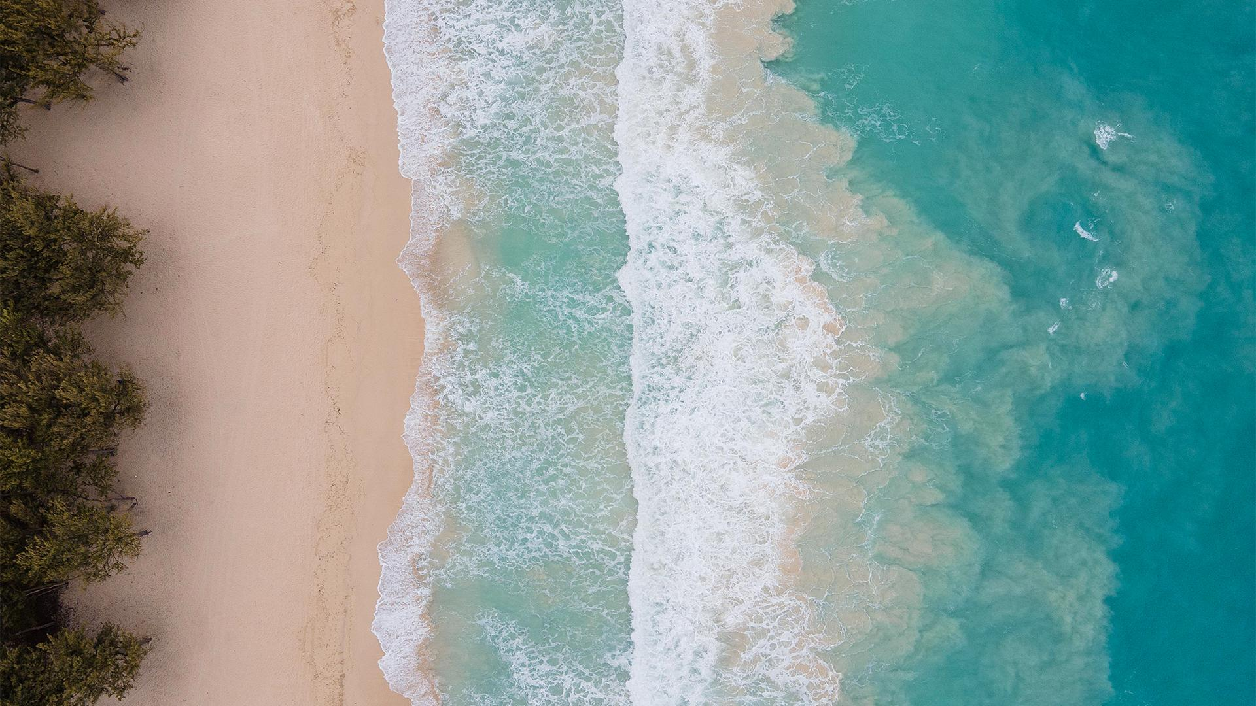
Jacques Cousteau's fun facts
One fun fact about Jacques Cousteau is that he was not actually his birth name. He was born as Jacques-Yves Cousteau, but he later added the hyphen and dropped his middle name to become simply Jacques Cousteau. He made this change in the 1940s, as he began to gain international recognition for his work in marine exploration and wanted a simpler and more distinctive name for his public persona.
Another fun fact about Cousteau is that he was a prolific inventor, with over 50 patents to his name. In addition to co-inventing the Aqua-Lung, which revolutionized underwater diving, he also developed a number of other underwater devices and instruments, including the underwater camera and the diving saucer. His innovative spirit and passion for exploration and discovery continue to inspire scientists and inventors around the world today.

Slide 11
Links
https://www.cousteau.org/legacy/expeditions/
https://en.wikipedia.org/wiki/Jacques_Cousteau#Early_life
https://redhatfactory.se/jaques-cousteau/
https://www.cousteau.org/legacy/expeditions/
https://www.britannica.com/biography/Jacques-Cousteau
https://www.filmweb.pl/film/Podwodne+%C5%BCycie+Jacques%E2%80%99a+Cousteau-2021-10003894

Slide 12
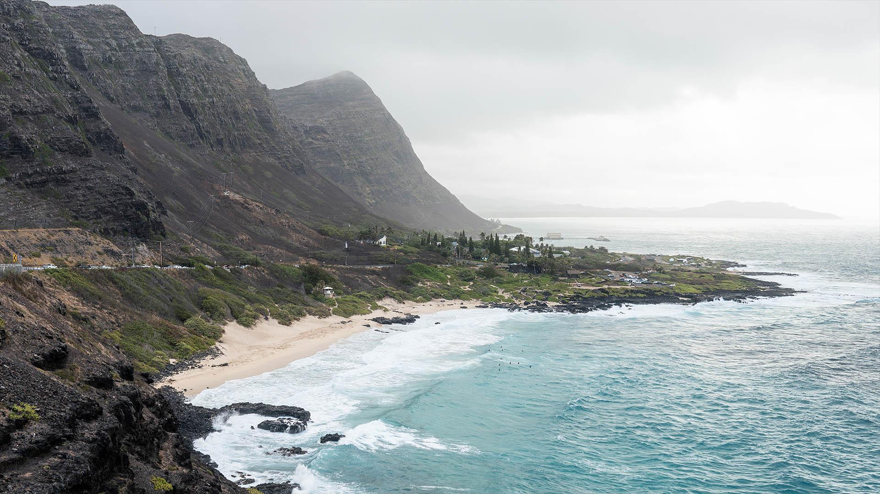















Thank you for your attention
Presentation made by
Natalia Makhnova and
Wiktor Gardyński
‘22

Slide 13
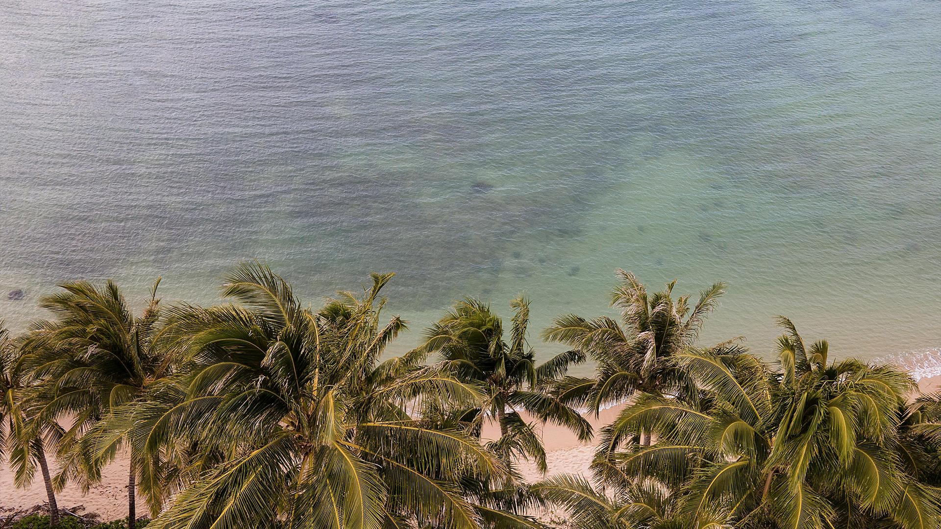

120
Number of Jacques Cousteau's expeditions

